Slide 1
Simple Generic UI Materials
to Improve Ul Performance
Daniel Janák & Andres Ibañez de Aldecoa

Slide 2
WHO WE ARE

Slide 3
WHO WE ARE
Vancouver
Dublin
Warsaw
Montreal
Paris
Prague
Kyiv
Montpellier
Lyon
San Francisco
Seoul
Tokyo
Los Angeles
Xi’an
Chengdu
Shanghai
Da Lat
Ho Chi Minh City
Kuala Lumpur
Singapore
3700+
22
900+
20
1500+
PEOPLE
LOCATIONS
CLIENTS
YEARS
TITLES

Slide 4
AGENDA
AND WHY WE
ARE HERE
01.
Traditional UMG layouting
02.
Material usage and benefits
03.
Alternative to UMG functionality in Materials
04.
Some material demos
05.
Performance Metrics
06.
Questions & Answers

Slide 5
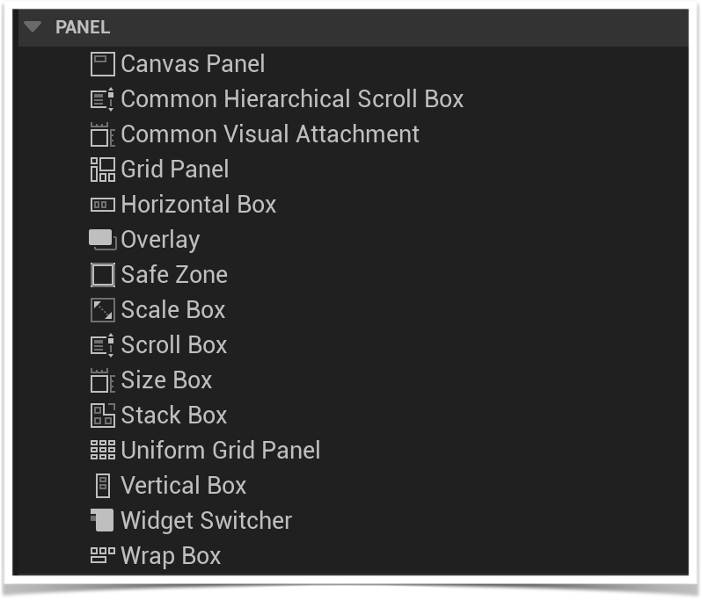
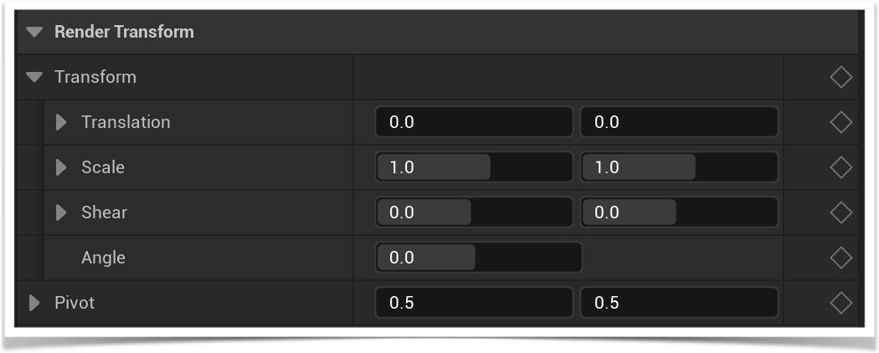
LAYOUTING
Panels and Render Transform
Batching
Layout pass CPU calculations
Extra widgets (Panels, and multiple children)
Layout Invalidation

Slide 6
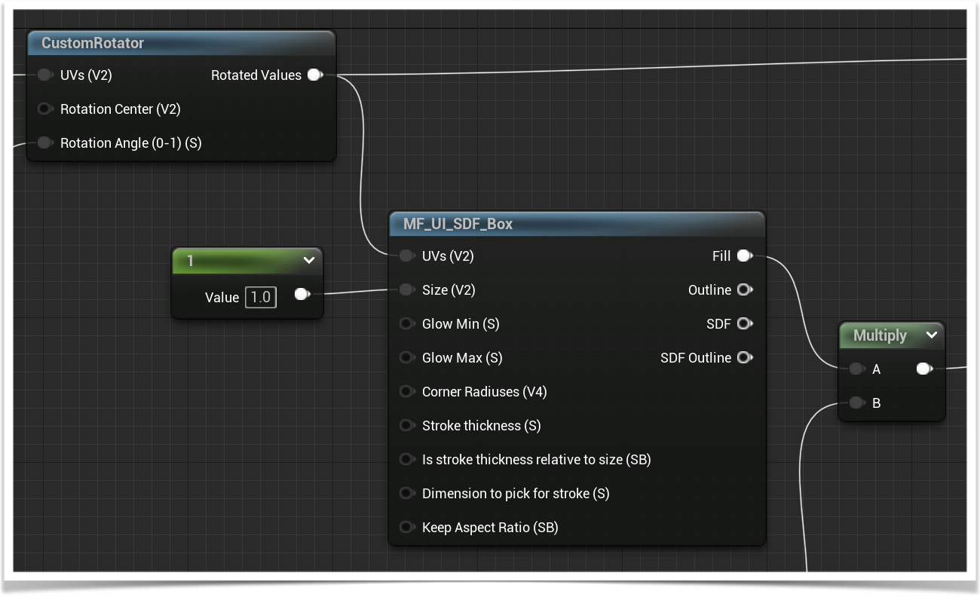
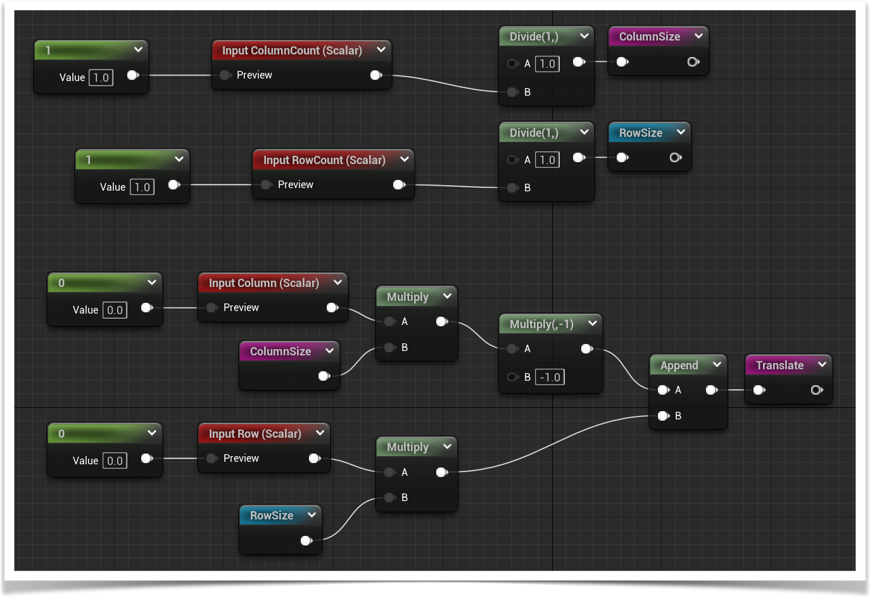
MATERIALS
Not just for fancy effects
Calculations run on GPU
Highly parallelised
Reduce batches
No layout invalidation
Reduce number of widgets used

Slide 7
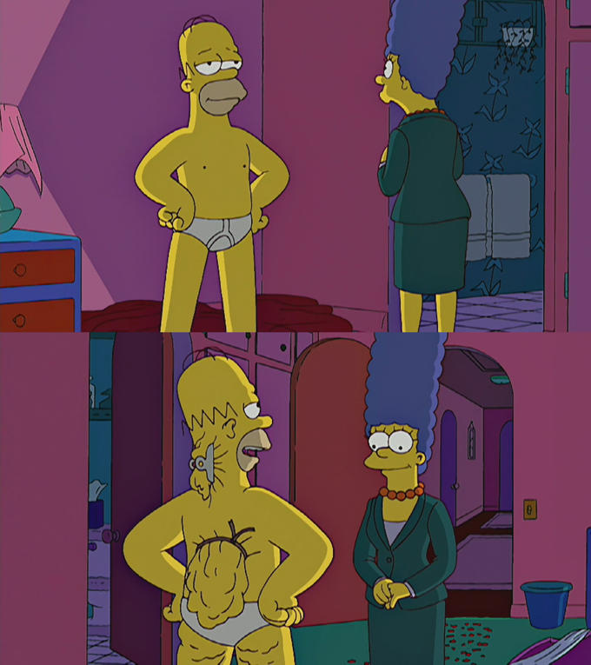
BUT WHY?
Additive performance gains
Seemingly innocent UI
No magic way to increase performance
Performance gain is additive
People underestimate/fear materials
More vertical integration
Saved time in a long run
Canvases
Transforms
Sea of Widgets

Slide 8
MATERIAL FUNCTIONALITY
Alternative to UMG functionality
Transforms
Overlays, Grids, other Panel functionality
Atlasing
Masking

Slide 9
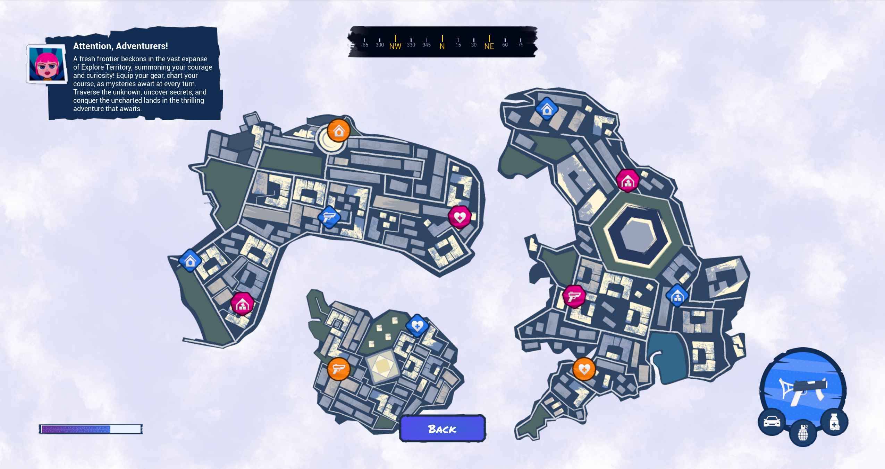
TIME FOR A DEMO
Prerequisites: UI Material Lab

Slide 10
PERFORMANCE
Emergence
We used simple materials
We used material instances
Performance difference
Single instance - negligible
Emerged as a whole - ?
↓38%
↓34%
↓47%
↓41%
↓77%

Slide 11
Q&A
The Bottom Line
Create UI with performance in mind from the start
Performance gain is usually additive
Great start with Materials are simple solutions
Q&A
Special thanks to Andres Ibañez de Aldecoa for additional Material support and performance analysis

Slide 12
Daniel Janák
Andres Ibañez de Aldecoa
djanak_a@virtuosgames.com
aibanez@virtuosgames.com
Notes:
Corentin
Thank you for your attention, do you have any questions?

